Slide 1
A framework for carbon monitoring and upscaling in forests across Mexico to support implementation of REDD+
Principal Investigator (PI)
Dr. Rodrigo Vargas
Assistant Professor, Plant and Soil Sciences, University of Delaware, Newark, DE, USA
Co-Principal Investigators (Co-PI)
Dr. Richard Birdsey
Project Leader, USDA Forest Service, Newtown Square, PA, USA
Dr. Kristofer Johnson
Research Biologist, USDA Forest Service, Newtown Square, PA, USA

Slide 2
Work Plan
Year 1–3
Objective 1: Standardize ongoing methodologies across sites.
Coordinate across sites to establish standardize data collection and data framework for modeling, validation, and scaling purposes.
Year 1–3
Objective 2: Characterize extremes and uncertainties.
Incorporate site-level measurements to validate landscape and regional products.
Year 2–3
Objective 3: Identify hot-spots suitable for REDD+ and assess forest vulnerability
Completed upscaling products, analysis of extreme values, and temporal trends of change across forests in Mexico. Online- data sharing of up-scaled information.

Slide 3
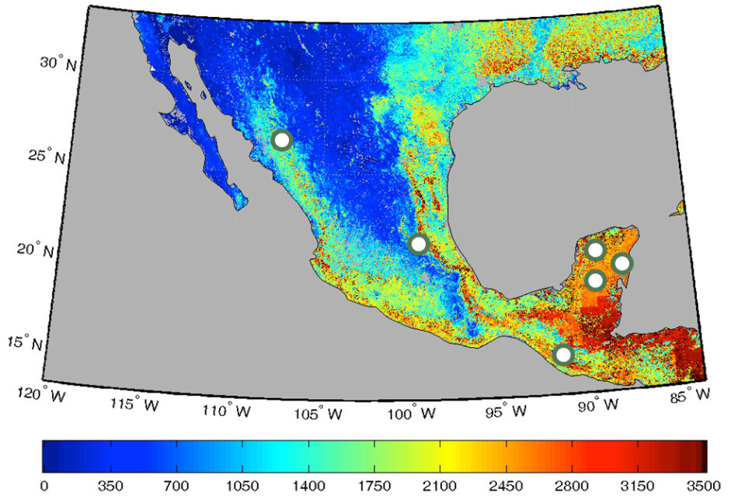
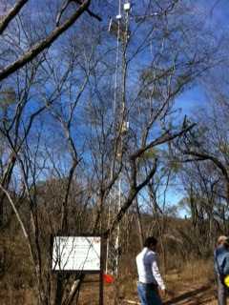
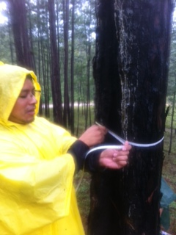
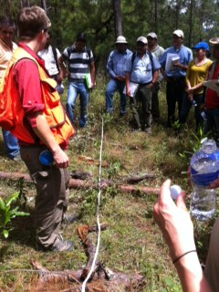
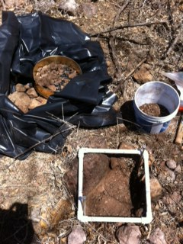
Data Collection
Intensive forest monitoring sites
Site | Location | Vegetation
Kaxil Kiuic | Yucatan | Deciduous broadleaf
Uyoolche | Quintana Roo | Deciduous broadleaf
La Encrucijada | Chiapas | Mangrove
Atopixco | Hidalgo | Evergreen needleleaf
Alamos | Sonora | Deciduous broadleaf
GPP, gC m-2 yr-1
Flux Tower
Aboveground Biomass
Down Woody Debris
Quantitative Soil Samp.

Slide 4
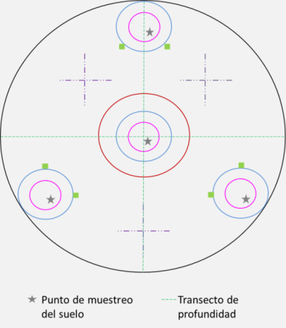
Intensive Site Design
Characteristics
1X1 km area densely sampled
3X3 total area (validation area)
Plots – FIA like design
Local academic institution to manage the site
Alamos, Sonora, Mexico

Slide 5
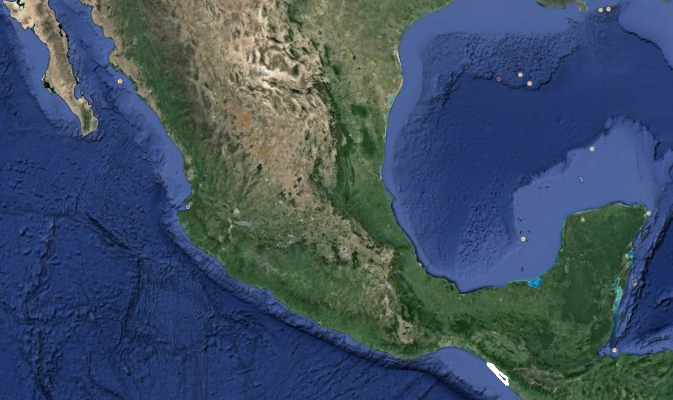
Study Site
Biosphere Reserve La Encrucijada
Notes:
New site added for biomass research and to install and eddy covariance site

Slide 6
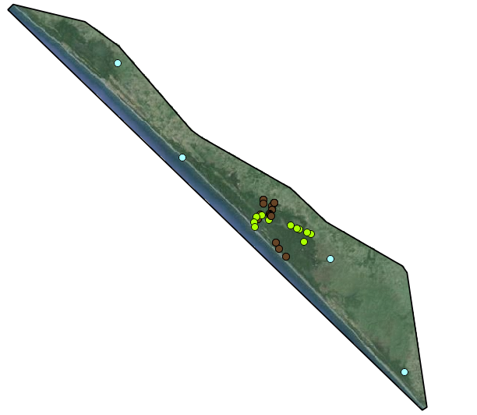
Ground based data
Biosphere Reserve La Encrucijada
Production (litterfall) 11 sites from 1999-2003, this database includes biophysical parameters (e.g. salinity, temperature).
Vegetation structure from 2009 to 2011.
CLIMCOM includes precipitation and temperature from 1980 to 2010.
Vegetation structure
Litterfall
CLICOM

Slide 7
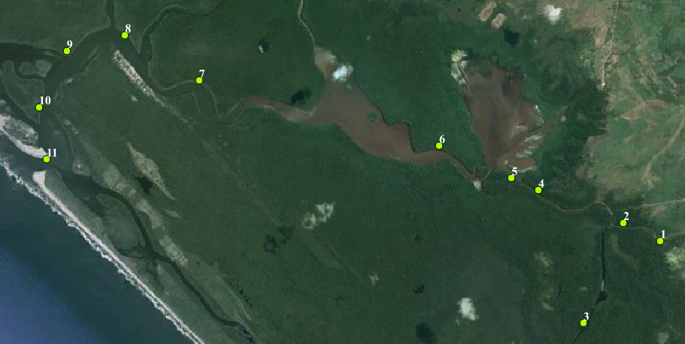
Litterfall sites are stablished following a gradient taking into account distance to inland, therefore we have two main clusters and a south away point from inland site.
Cluster 1 (green circle)
Cluster 2 (orange circle)
Point (blue circle)
Notes:
The following biophysical parameters are measured along with litterfall collection:
Temperature (C): at 1.5 m.a.s.l.
Salinity: PSU
Interstitial salinity: PSU
Relative humidity : 30 cm above soil surface level
pH: at 30 cm
Flood level
Organic matter

Slide 8
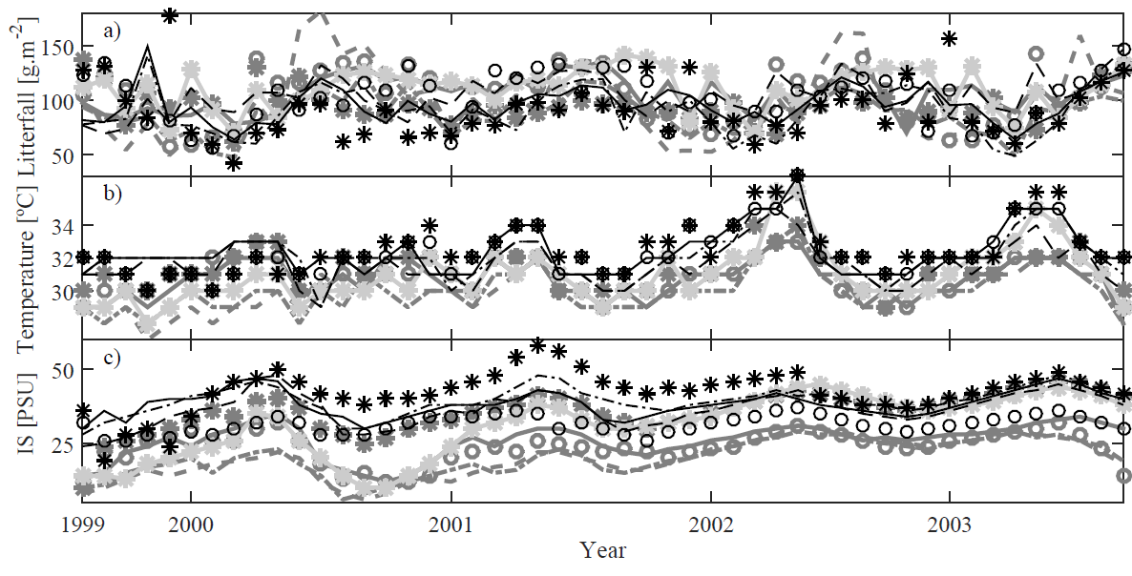
La encrucijada
Sites
Seasonality in Litterfall production is observed along with biophysical parameters such as temperature and interstitial salinity (IS)
Sites closest to inland have less IS and lower temperature resulting in a slightly higher litterfall production

Slide 9
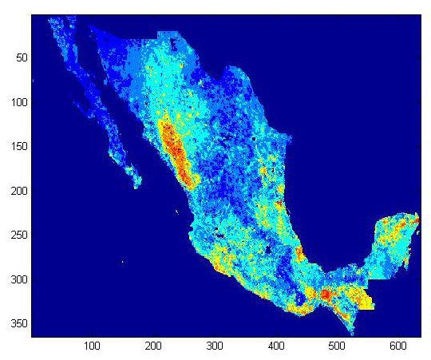
Hotspots of carbon change between 2000 - 2012
Notes:
We combined GPP derived from MODIS between 2000-2012 and carbon inventories data from soils, belowground and aboveground for 2000 and 2007. Then we applied a standard euclidian distance approach to identify areas of changes. These areas could be gains or losses but are represented by red regions in this figure. Note the importance of the State of Sinaloa who has been overseen by REDD+ activities….also seee Chiapas as an important region.

Slide 10
a
b
c
d
Mean Standard Euclidian Distance
e
0.36-0.57
0.58-0.62
0.63-0.66
0.67-0.7
0.71-0.91
Human Development Index
Low
High
Notes:
In order to identify where are these areas with high standard euclidiand distances (SED, i.e., areas of high rates of carbon change) we looked at the relationship between SED and the human development index….we found that areas with low HDI are areas with high SED…..so areas where poor people leave are areas with high potential for carbon change in Mexico.
Letters show significant differences in means of SED (ANOVA test followed by a Tukey test)

Slide 11
Causes of Forest Disturbances by Country Not including Indirect Human-Induced
Percentage of disturbed forest land by cause, per year
Mostly deforestation and forest degradation
2.1%
2.9%
3.2%
Percentage of forest land disturbed annually

Slide 12
Results from Year 1
Activity | Data (status)
1. Continued data collections at 2 sites – Atopixco and Kiuic. | Aboveground biomass (100%) Down woody debris (100%) Soil bulk density (100%) Lab soil analyses - C, N, texture, water holding capacity (~50%)
2. Established new data collections at 2 site – Alamos and La Encrucijada | Aboveground biomass (~20%) Down woody debris (~75%) Soil bulk density (~90%) Lab soil analyses (0%)
3. Started DNDC modeling at Atopixco and Kiuic. | Kiuic: NEP outputs finished – Dai et al. 2014. (but could use refining with new data) Atopixico: model calibrating stage for baseline NPP/GPP.
4.- Identification of hotspots of carbon change across Mexico | Preliminarily assessment of SED between 2000-2010

